Slide 1
Presentation on L1 : Module 2

Slide 2

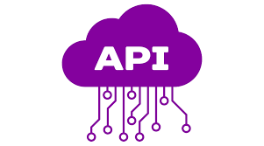

Go Lang -Basics
Git Training – Basics
Code standards and style guide
Golang API Task
Contents:

Slide 3
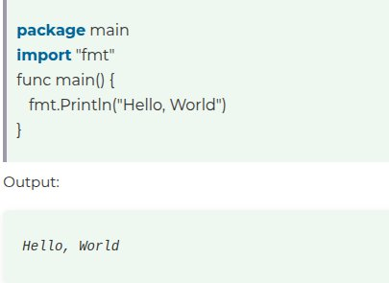
Go Language
Basic Structure of go program:
Go is a programming language which is developed by Google with the vision of fast development and high performance. Go provides type safety, garbage collection, dynamic-typing capability, many advanced built-in types such as variable length arrays and key-value maps etc.
It is an open-source project: Google imports the public repository rather than the other way around.
Go is modern, fast and comes with a powerful standard library.
Go uses interfaces as the building blocks of code reusability.
Package Declaration
Import Packages
Variables
Statements and Expressions
Functions
Comments

Slide 4
Why GO Language was developed?
Concurrency: Go was designed with built-in support for concurrent programming. It introduced goroutines and channels, which make it easier to handle multiple tasks simultaneously without the complexity often associated with traditional threading models.
Simplicity and Efficiency: The creators aimed to create a language that is simple to learn and use, allowing developers to write clear and maintainable code. Go’s syntax is clean and straightforward, reducing the cognitive load on programmers.
Performance: Go compiles to machine code, which allows for high performance similar to languages like C and C++. This is crucial for developing efficient software that can handle heavy loads, as required in Google’s infrastructure.
Dependency Management: The language includes features that simplify dependency management and reduce issues related to package management, making it easier to build and maintain large applications.
Tooling: Go was developed with strong tooling support, including a built-in formatter (gofmt), documentation generation, and a robust standard library, enhancing the overall developer experience.
Scalability: Given Google’s need for highly scalable systems, Go was designed to facilitate the development of distributed systems and microservices, making it well-suited for cloud computing environments.

Slide 5
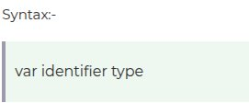
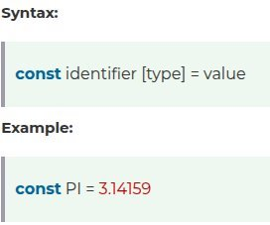

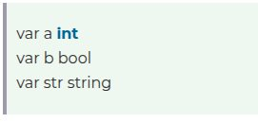
Go Data Types:
Variables can be of different types like int, float, struct, slice or it can be of the interface.
The general form for declaring a variable uses the keyword var:
Go Constants:
A constant const contains data which is not changed. This data can only be of type boolean, number (integer, float or complex) or string.
Go If:
The if statement in Go is used to test the condition. If it evaluates to true, the body of the statement is executed. If it evaluates to false, if block is skipped.
Syntax:

Slide 6
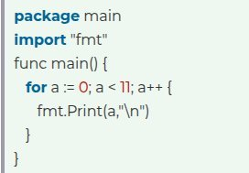
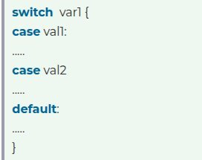
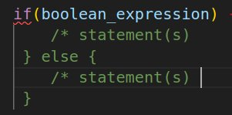
Go if-else:
The if-else is used to test the condition. If condition is true, if block is executed otherwise else block is executed.
Syntax :
Go switch:
The Go switch statement executes one statement from multiple conditions. It is similar to if-else-if chain statement.
Syntax:
Go For Loop:
The Go for statement is used for repeating a set of statements number of times. It is the only loop in go language.
Syntax:

Slide 7
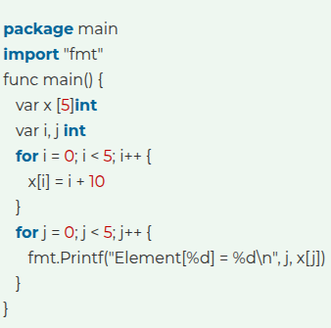
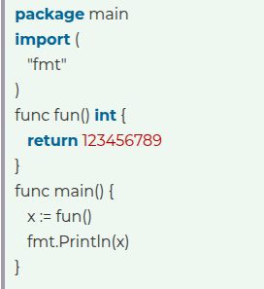
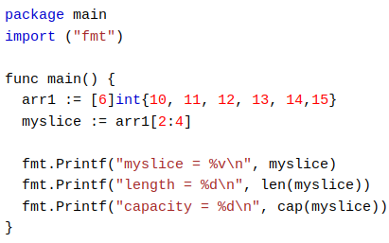
Go Functions:
In Go, functions are the basic building blocks. A function is used to break a large problem into smaller tasks. We can invoke a function several times, hence functions promote code reusability.
Go Array:
In Go, an array is a homogeneous data structure (Fix type) and has a fixed-length. The type can be anything like integers, string or self-defined type.
Go Slices:
Slices are similar to arrays, but are more powerful and flexible.
Like arrays, slices are also used to store multiple values of the same type in a single variable.
However, unlike arrays, the length of a slice can grow and shrink as you see fit.

Slide 8
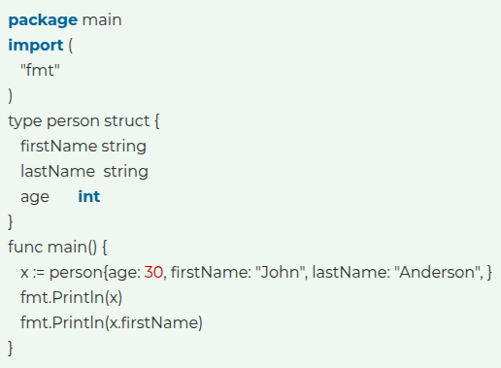
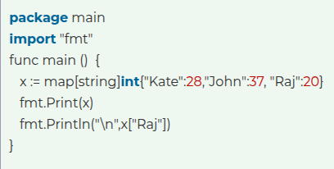
Go Struct:
In Go, Struct can be used to create user-defined types.
Struct is a composite type means it can have different properties and each property can have their own type and value.
Go Maps:
Maps are used to store data values in key:value pairs.
Each element in a map is a key:value pair.
A map is an unordered and changeable collection that does not allow duplicates.
The length of a map is the number of its elements. You can find it using the len() function.

Slide 9
Git-Basics:
What Is Version Control?
A system called version control, sometimes referred to as source control or revision control, keeps track of changes made to a file or group of files over time so that you may retrieve particular versions at a later time. Although it can be applied to any circumstance where several versions of something are made and may need to be monitored and recalled.
What is GitHub?
GitHub is a web-based platform that uses Git, a version control system, to help developers manage and track changes in their code. It allows multiple people to collaborate on a project, track revisions, and contribute to code from anywhere in the world.

Slide 10
Some Basic Git Commands:
git init: Initialize a local Git repository
git clone ssh://git@github.com/[username]/[repository-name].git: Create a local copy of a remote repository
git status: Check status
git add [file-name.txt]: Add a file to the staging area
git commit -m "[commit message]": Commit changes
git branch [branch name]: Create a new branch
git branch –a: List all branches
git branch -d [branch name]: Delete a branch
git checkout -b [branch name]: Create a new branch and switch to it
git branch -m [old branch name] [new branch name]: Rename a local branch
git checkout [branch name]: Switch to a branch
git merge [branch name]: Merge a branch into the active branch
git push -u origin [branch name]: Push changes to remote repository (and remember the branch)
git push: Push changes to remote repository
git pull: Update local repository to the newest commit
git log: View changes
git log –oneline: View changes (briefly)
Key Features of Git:
Version Control
Repositories
Branches
Pull Requests
Issues and Project Management

Slide 11
Code standards and style guide:
Coding standards are a set of guidelines and best practices that developers follow while writing code. These standards cover various aspects such as naming conventions, code organization, indentation, commenting, error handling, and more.
A style guide is a set of standards for the writing, formatting, and design of documents. The standards documented in a style guide are applicable for either general use, or prescribed use in an individual publication, particular organization, or specific field.
Purpose of having Coding Standards
Consistency: Ensures uniformity across codebases.
Readability: Well-defined standards enhance code readability.
Error Prevention: Helps catch common mistakes early, preventing bugs and improving code quality.
Scalability: Ensures code can scale without becoming unwieldy or unmanageable.
Cross-Team Collaboration: Shared standards facilitate collaboration.
Code Reviews: Standards provide clear criteria for code reviews, leading to more effective feedback.
Efficient Maintenance: Following standards simplifies debugging, refactoring, and maintenance tasks.

Slide 12
g
SOME COMMON TERMS IN CODE STANDARDS AND STUDY GUIDE
CANONICAL:
Within these documents, “canonical” is used to describe something that is considered a standard that all code (old and new) should follow and that is not expected to change substantially over time. Principles in the canonical documents should be understood by authors and reviewers alike, so everything included within a canonical document must meet a high bar.
NORMATIVE:
Within these documents, “normative” is used to describe something that is an agreed-upon element of style for use by Go code reviewers, in order that the suggestions, terminology, and justifications are consistent. These elements may change over time, and these documents will reflect such changes so that reviewers can remain consistent and up-to-date.
IDIOMATIC:
Within these documents, “idiomatic” is used to refer to something that is prevalent in Go code and has become a familiar pattern that is easy to recognize. In general, an idiomatic pattern should be preferred to something unidiomatic if both serve the same purpose in context, as this is what will be the most familiar to readers.

Slide 13
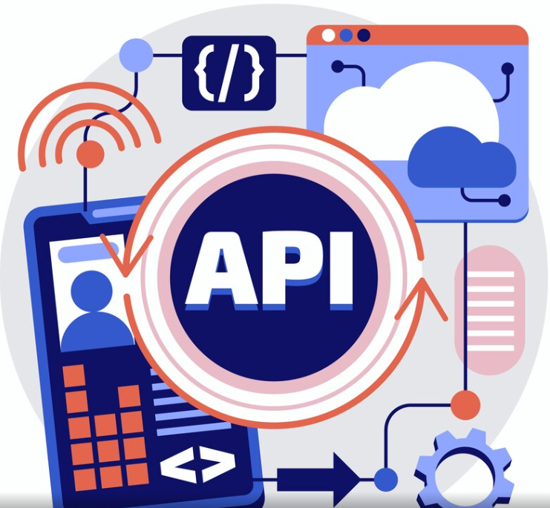
Golang API Task: What is API? API full form is an Application Programming Interface that is a collection of communication protocols and subroutines used by various programs to communicate between them. A programmer can make use of various API tools to make their program easier and simpler. It takes the request from the user and sends it to the service provider and then again sends the result generated from the service provider to the desired user. Task Overview: In This task we have used go language and its go gin framework to create API, which is going to communicate with SQL database which has been connected with the database using generic database package(database/go). Then we have imported modernsqlite drivers which is registered with database/SQL package. This task majorly focused on CRUD operations that we are performing on the database via connecting to a port(here 8080). Using postman tool we are performing those crud operations. GITHUB link to access different files: link or Visit: https://github.com/Lovepreet5555/taskmanagement-xenon

Slide 14
Input Output diagram
USER
CONTROLLER
Create Task
Update Task
Delete Task
GET Task
LIST Task
HTTP Request
HTTP Response
CONTROLLER
MODEL
ExecDB
QueryDB
Validate Input
Return Data
MODEL
CRUD Operations
Execute Query
Query Result
DATABASE
Tasks Table
DATABASE

Slide 15
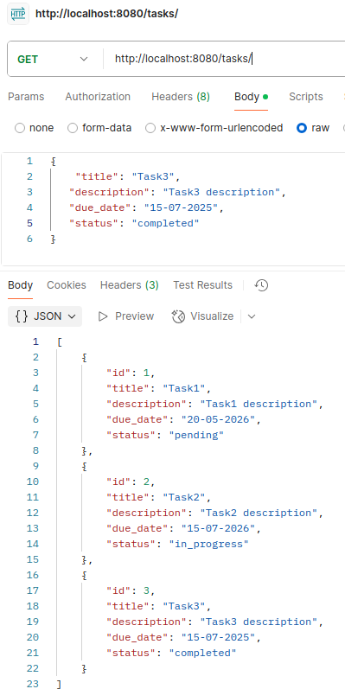
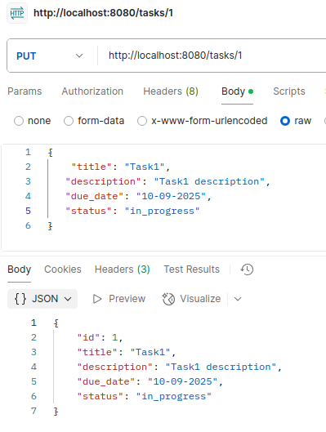
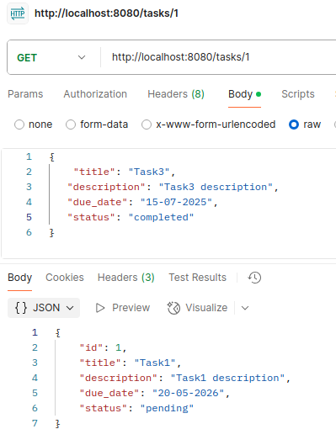
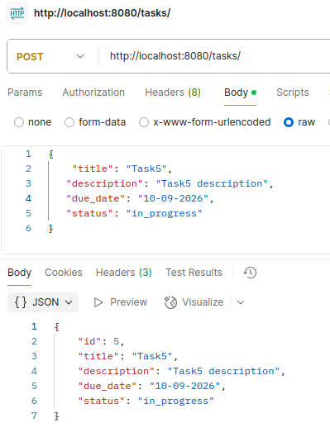
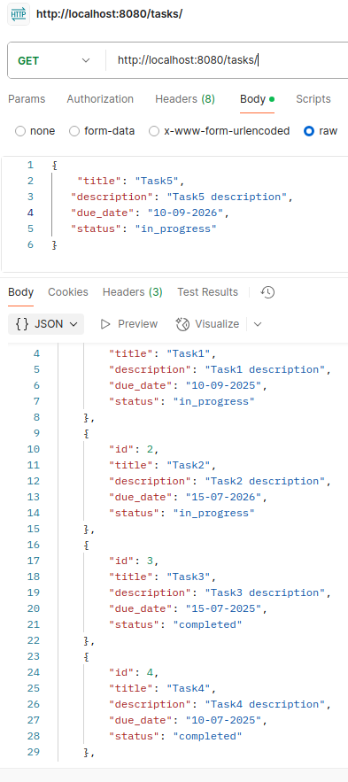
TASK INSIGHTS:

Slide 16
Thank you
Lovepreet Singh
XS0905
love@xenonstack.com

